Slide 1

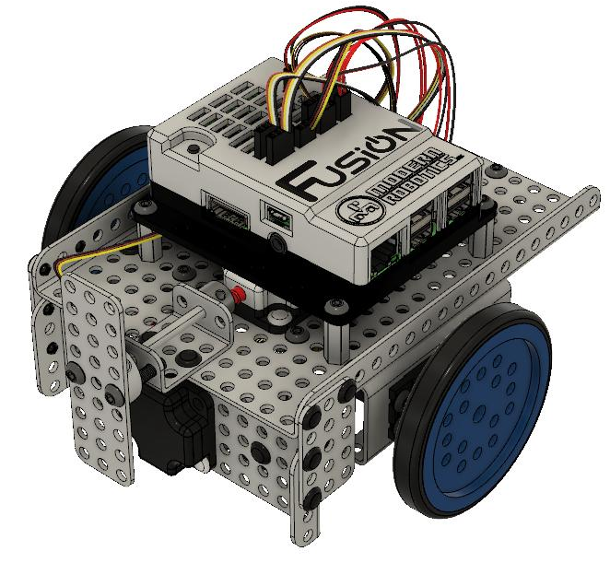

Modifying the Mimio MyBot BaseKit to add the Planetary Exploration Pack
Version 1.2a
Boxlight Robotics

Slide 2
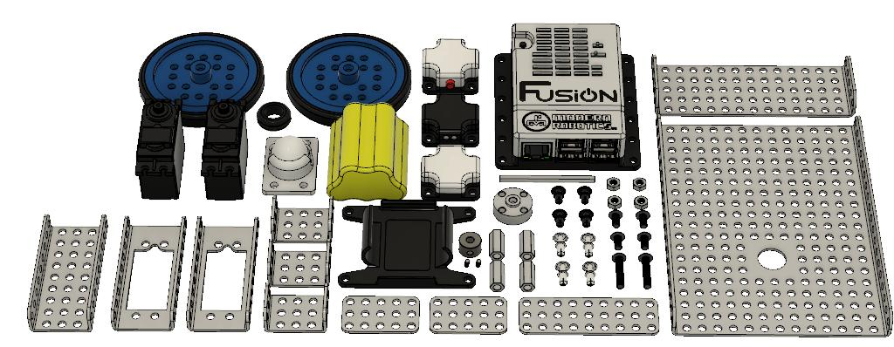
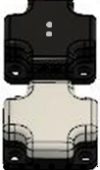
BaseKit plus Planetary Exploration Pack
Use these step-by-step instructions to add the Planetary Exploration Sensor Pack to a MyBot BaseKit Robot.
Copyright 2018-2020, Boxlight Robotics, All Rights Reserved
No part of this document may be copied, published in print or shared online or otherwise publicly released without the express written consent of Boxlight Robotics.
Note: Specifications listed are subject to change without notice.

Slide 3
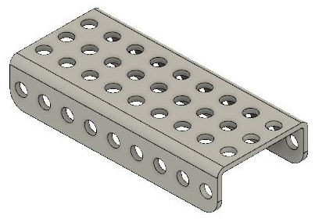
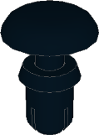
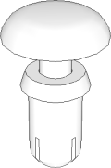
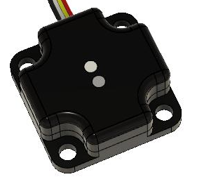
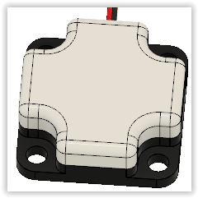
Illustrated List of Components Needed
Extra components from the original Base Kit Build |  | New components in the Planetary Exploration Pack
x2 11-6001 Quick Connect Short |  | X1 06-0009 9 Hole C Shaped Beam
x4 11-6002 Quick Connect Medium |  | X1 45-2018 Color Sensor
 |  | X1 45-2020 Magnet Sensor

Slide 4
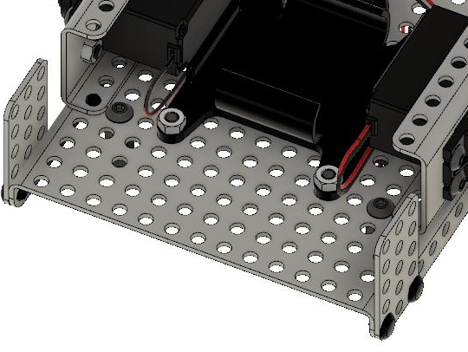
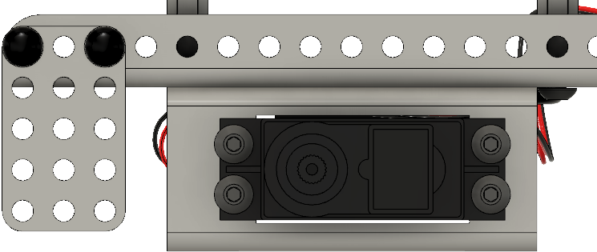

Verify Motor Mounting Placement
During the build of the MyBot BaseKit, the motor mounting plates should have been mounted using the 5th hole from the edge of the base plate (leaving four (4) empty holes in front of the motor mounting plates).
This creates an 8mm gap between the motor mounts and the 3x5 plates as shown below:
5th Hole
Confirm four (4) empty holes in front of motor mounts
Approx 8mm Gap
If the motors are not mounted as shown above, please move the motors to insure there is an approximate 8mm gap between the 3x5 flat plates and the motor mounting brackets.

Slide 5

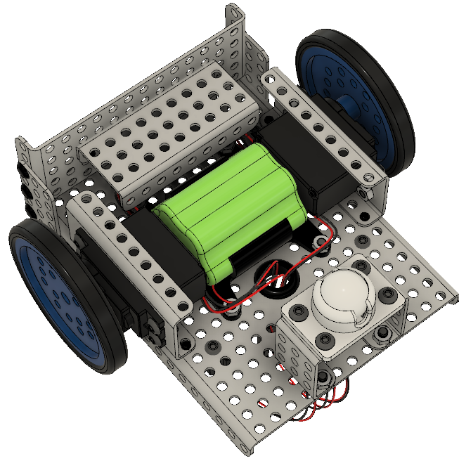

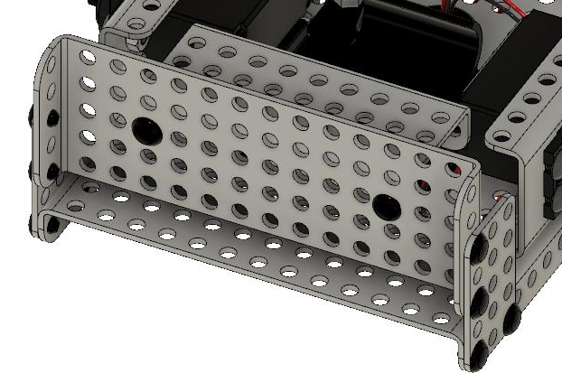
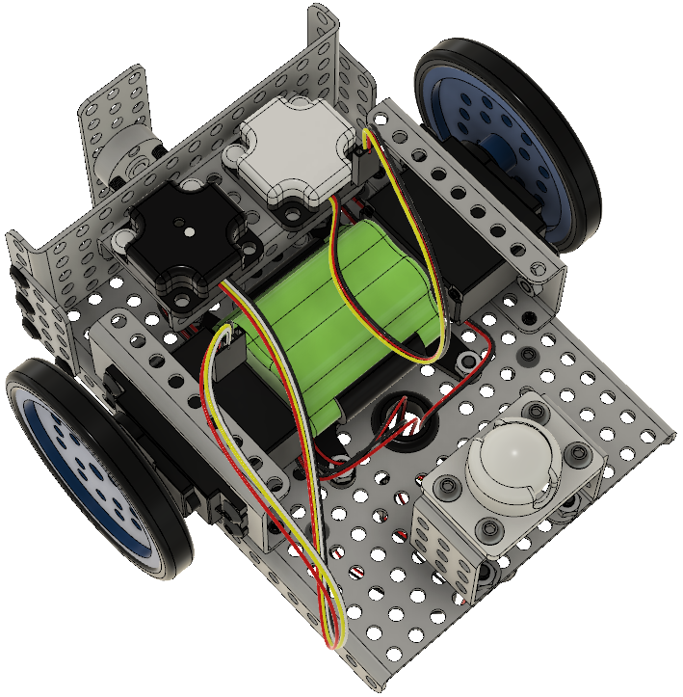

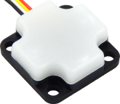

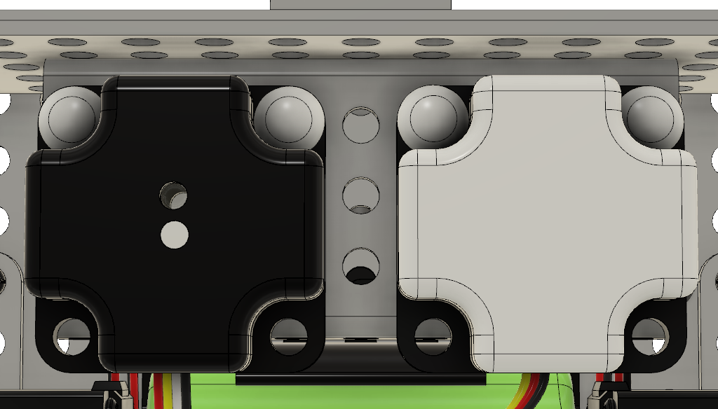
1
x1
x2
2
x1
x1 (Magnetic Field Sensor)
x4

Slide 6

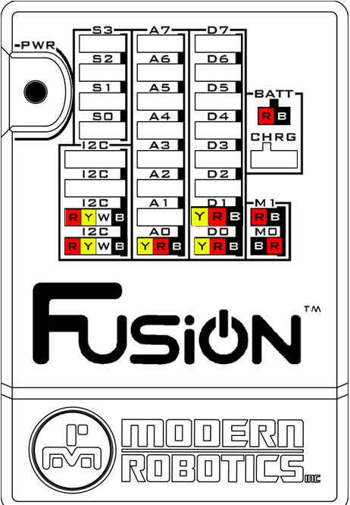
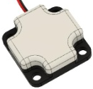



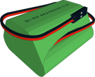
3 – Wiring
Optical Distance Sensor | → | A0
Magnetic Field Sensor | → | A1
Touch Sensor | → | D0
Color Sensor | → | I2C
Integrating Gyro | → | I2C
Left Motor | → | M1
Right Motor | → | M0
Battery | → | BATT
M0
M1

